Slide 1
FOURIER QUANTUM CONVOLUTIONAL NEURAL NETWORK (FQCNN)

Slide 2
FQCNN
Reason
Data Encoding
Amplitude Embedding
Quantum Fourier Transform (QFT)
Quantum Fourier Transform
Introduction
Classical Fourier Transform
Quantum Fourier Transform
QFT Convolution
Quantum Convolution
The procedure of QFT Convolution
Tomography

Slide 3
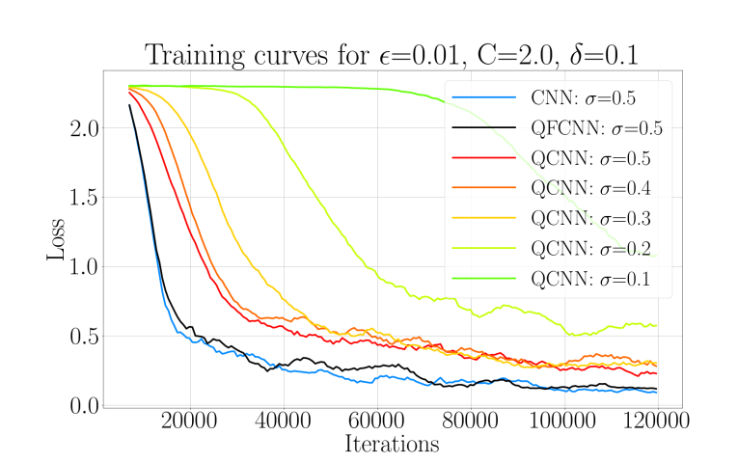
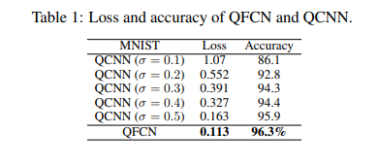
Reason
Besides being a novel and valuable research topic, it also demonstrates several advantages over the QCNN model in terms of optimizing model data and computation speed.

Slide 4
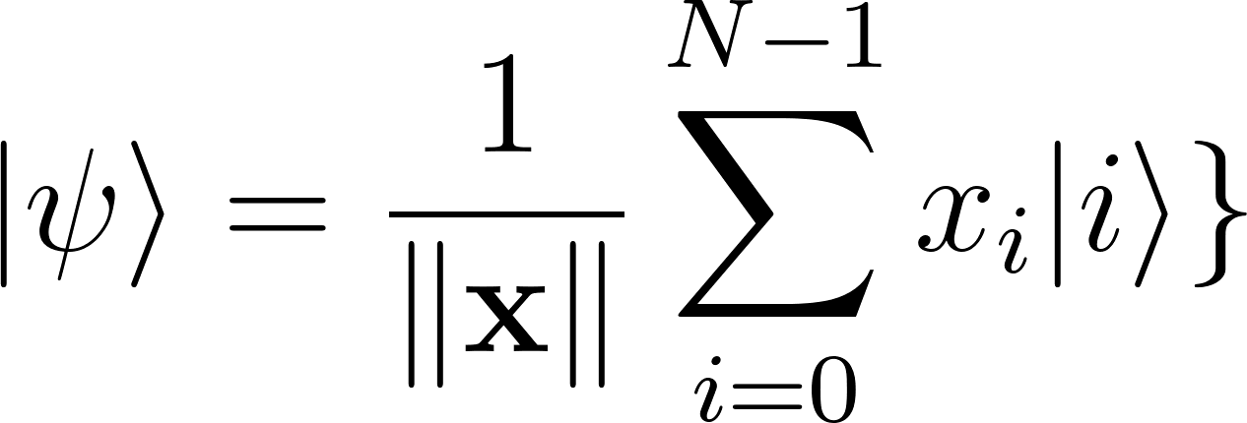
Encoding
Amplitude Embedding:
A normalized classical N-dimensions datapoint x is presented by the Amplitude of a n-qubits quantum state as:
Where:
∣i⟩ represents the basis states of the qubits.
x_{i} is the i-th element of x.
∥x∥ is the norm (magnitude) of the vector x.
For N classical data points, we require Log2(N) qubits.

Slide 5
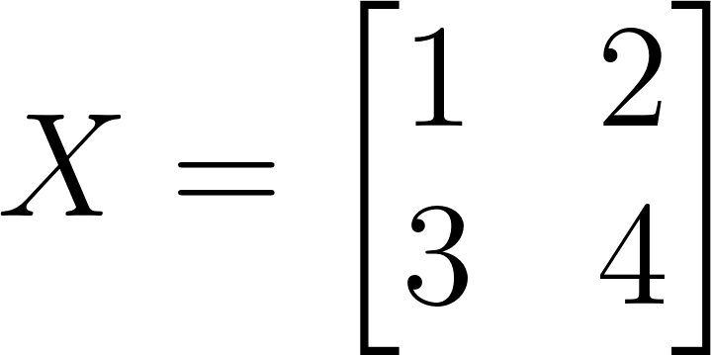
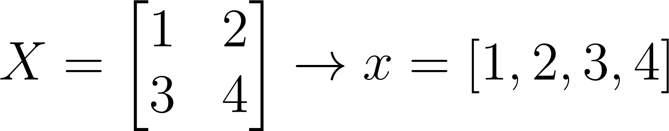
Encoding
Amplitude Embedding:
For example: there is a simple image dataset with a 2x2 pixel image named

Slide 6
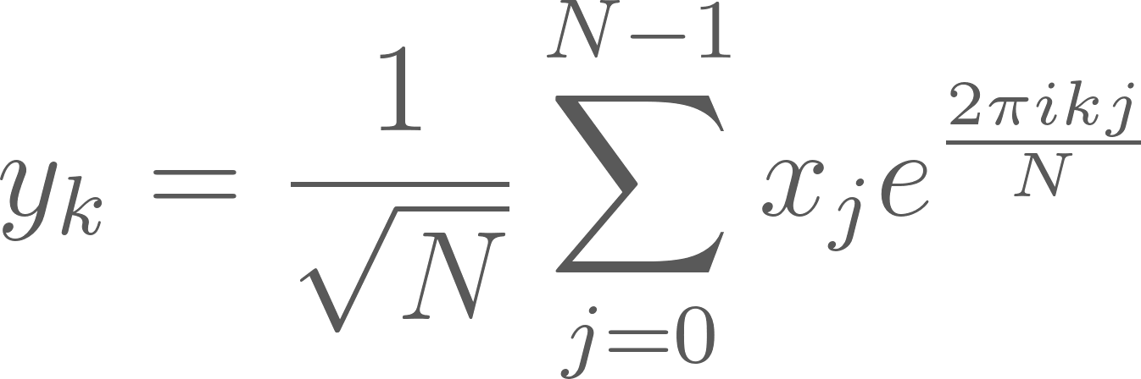
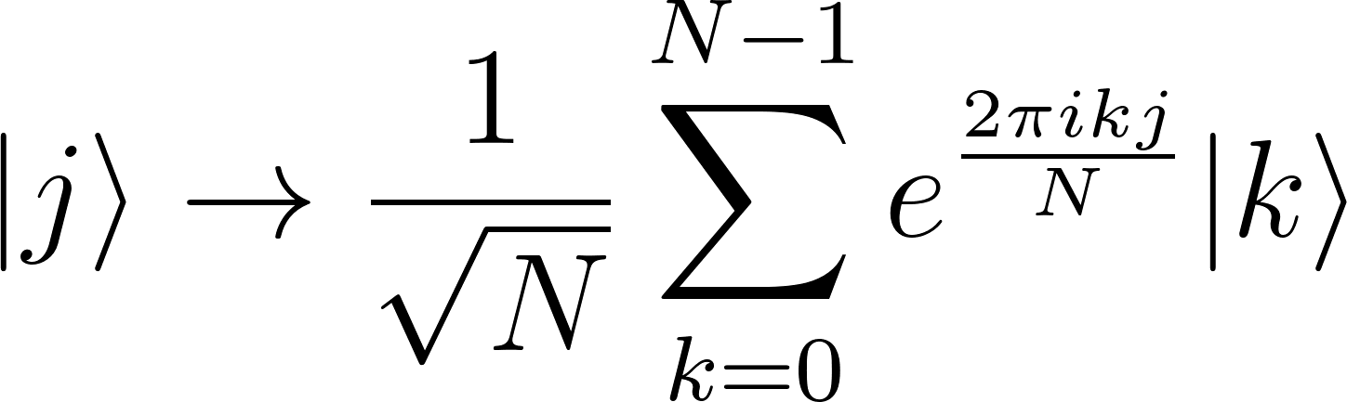
Encoding
Fast Fourier Transform (FFT)
With the vector x = (x₀,x₁,...,x_{N-1})^{𝐓}, we can map to vector y =(y₀,y₁,...,y_{N-1})^{𝐓} as follows:
In a quantum state, we use the Quantum Fourier Transform (QFT), which is essentially the same as the FFT except for differences in the input and output:

Slide 7
Quantum Fourier Transform
Quantum Fourier Transform
Introduction
Classical Fourier Transform
Quantum Fourier Transform

Slide 8
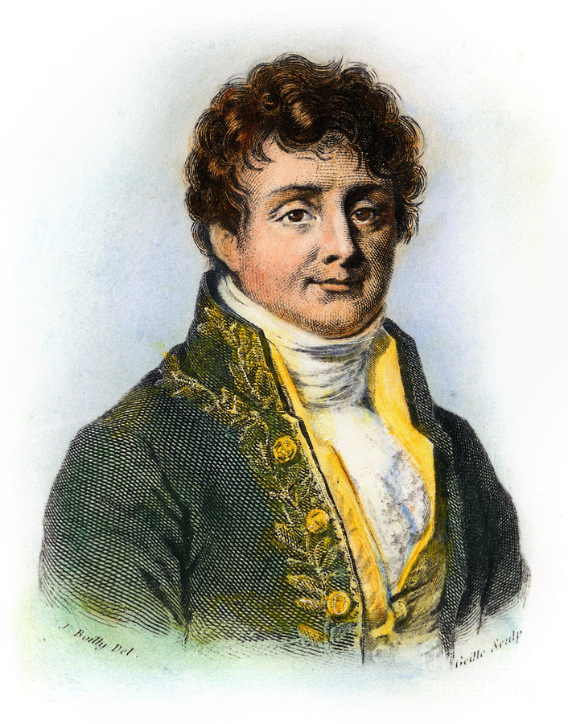
Introduction
Fourier Transform (Joseph Fourier) occurs in many different versions throughout classical computing, in areas ranging from signal processing to data compression to complexity theory.
The quantum Fourier transform (QFT) is the quantum implementation of the discrete Fourier transform over the amplitudes of a wavefunction. Most notably applications are Shor's factoring algorithm and quantum phase estimation.
Joseph Fourier

Slide 9
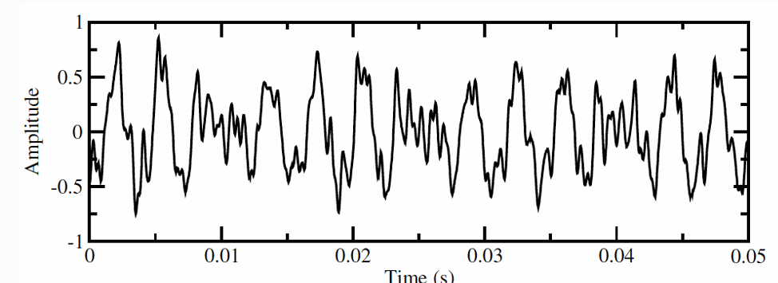
Classical Fourier Transform
Assume we have a piano sound sequence represented as a graph over time as follows

Slide 10
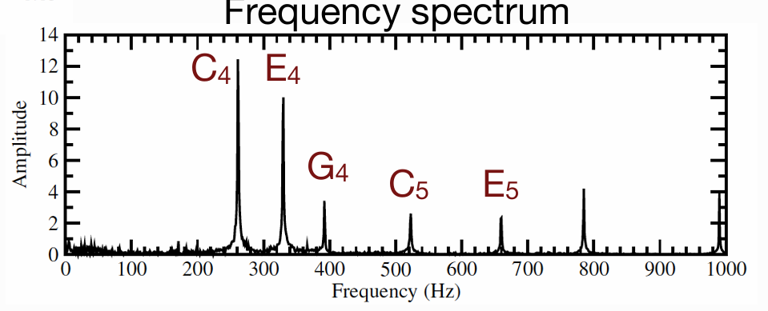
Classical Fourier Transform
With the discrete Fourier transform, we can convert it into a frequency table as shown.
From this, it can be observed that the C4 note is the main sound of the piece.

Slide 11

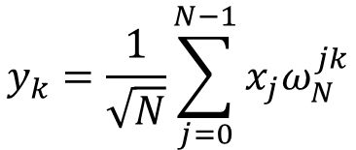

Classical Fourier Transform
Discrete Fourier Transform acts on a vector (x₀, x₁, x_{2…}) and map it to the vector (y₀, y₁, y₂…) according to the formula:
$$y_{k}=\frac{1}{\sqrt{N}}\sum_{j=0}^{N−1}{x_{j}ω_{N}^{jk}}$$
$$k ∈\left\{0, 1, 2, …N−1\right\}$$
$$with ω_{N}^{jk}=e^{2πi\frac{jk}{N}}$$
$Ví dụ: y_{0}=\frac{1}{\sqrt{N}}(a_{0}+a_{1}+a_{2}+….+a_{N−1})$, $y_{1}=\frac{1}{\sqrt{N}}(a_{0}+a_{1}ω+a_{2}ω^{2}+….+a_{N−1}ω^{N−1}$

Slide 12
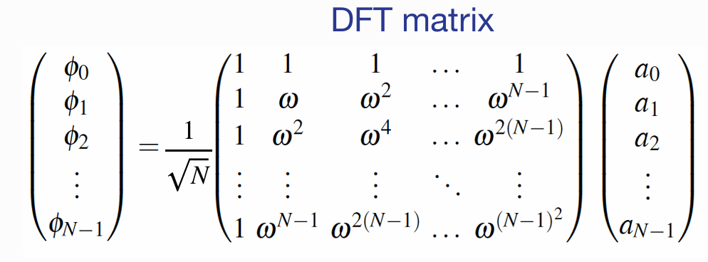
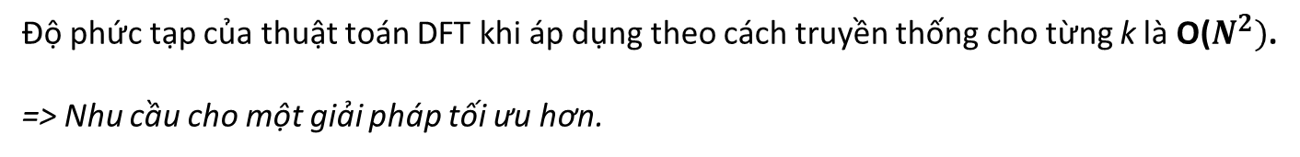
Classical Fourier Transform
Độ phức tạp của thuật toán DFT khi áp dụng theo cách truyền thống cho từng k là O($N^{2})$.
=> Nhu cầu cho một giải pháp tối ưu hơn.

Slide 13
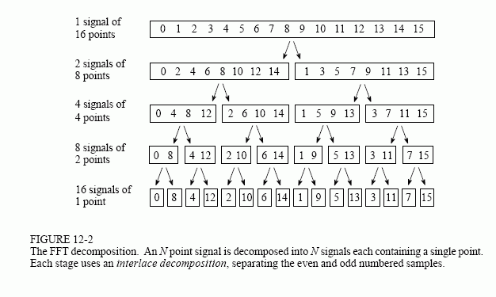
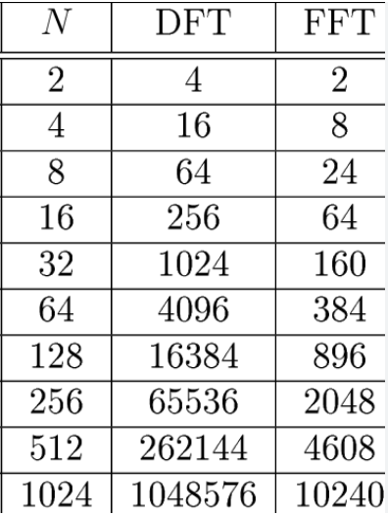
Classical Fourier Transform
Bảng so sánh
Thuật toán FFT giảm độ phức tạp với mẫu $N=2^{m}$ từ $O\left(N^{2}\right) xuống O(N\log_{2}{N).}$

Slide 14
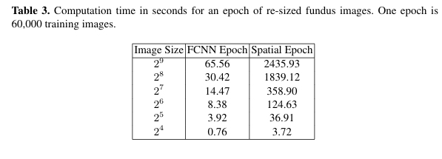
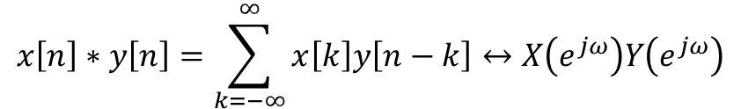
Classical Fourier Transform
$$x\left[n\right]∗y\left[n\right]=\sum_{k=−∞}^{∞}{x\left[k\right]y\left[n−k\right]↔X\left(e^{jω}\right)Y\left(e^{jω}\right)}$$
The above equation states that the convolution of two signals is equivalent to the multiplication of their Fourier transforms. Therefore, by transforming the input into frequency space, a convolution becomes a single element-wise multiplication. In other words, the input to a convolutional layer and kernel can be converted into frequencies using Fourier transform, multiplied once and then converted back using the inverse Fourier transform.

Slide 15
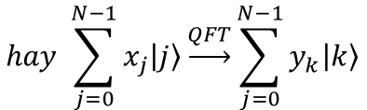
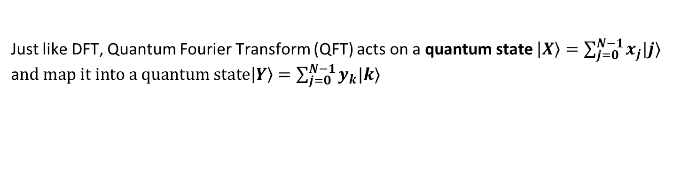
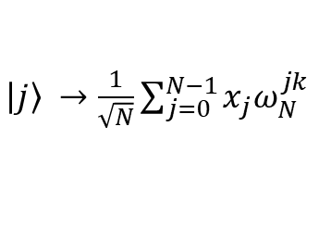
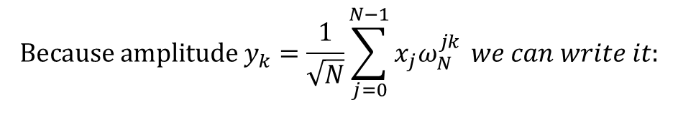
Quantum Fourier Transform
Just like DFT, Quantum Fourier Transform (QFT) acts on a quantum state $\left|X\right\rangle =\sum_{j=0}^{N−1}{x_{j}|j⟩}$ a$nd map it into a quantum state\left|Y\right\rangle =\sum_{j=0}^{N−1}{y_{k}|k⟩}$
$$hay \sum_{j=0}^{N−1}{x_{j}\left|j\right\rangle \underset{→}{QFT}}\sum_{j=0}^{N−1}{y_{k}\left|k\right\rangle }$$
$$Because amplitude y_{k}=\frac{1}{\sqrt{N}}\sum_{j=0}^{N−1}{x_{j}ω_{N}^{jk}} we can write it:$$
$\left|j\right\rangle →$ $\frac{1}{\sqrt{N}}\sum_{j=0}^{N−1}{x_{j}ω_{N}^{jk}}$

Slide 16
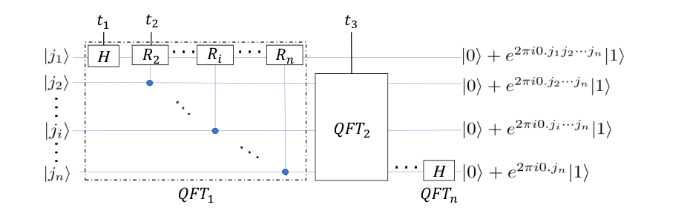
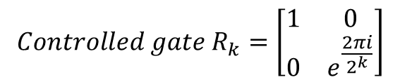
Quantum Fourier Transform
Bảng mạch QFT
$${Controlled gate R}_{k}=\left[\begin{matrix}1 & 0 \\ 0 & e^{\frac{2πi}{2^{k}}}\end{matrix}\right]$$

Slide 17
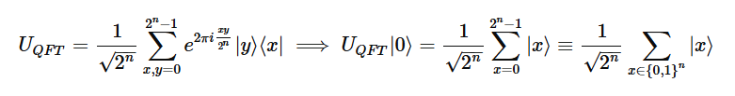
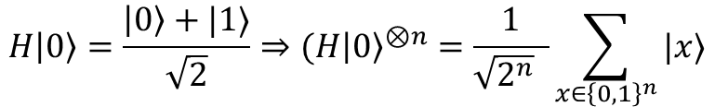
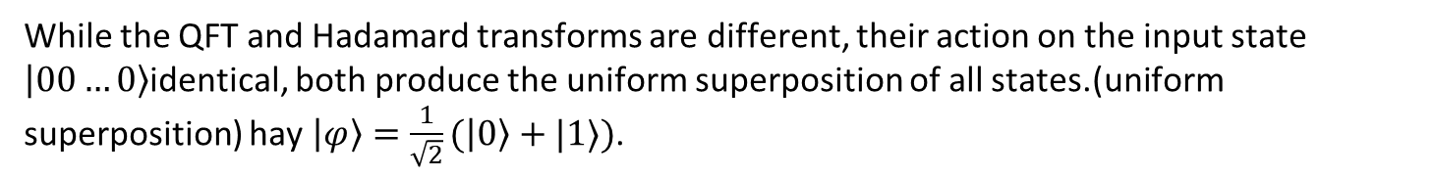
Quantum Fourier Transform
While the QFT and Hadamard transforms are different, their action on the input state $\left|00…0\right\rangle$identical, both produce the uniform superposition of all states.(uniform superposition) hay $\left|φ\right\rangle =\frac{1}{\sqrt{2}}(\left|0\right\rangle +|1⟩)$.
Hadamard transform:
$$H\left|0\right\rangle =\frac{\left|0\right\rangle +|1⟩}{\sqrt{2}}⇒(H{\left|0\right\rangle }^{⊗n}=\frac{1}{\sqrt{2^{n}} }\sum_{x∈{\left\{0, 1\right\}}^{n}}{|x⟩}$$
Fourier transform:

Slide 18
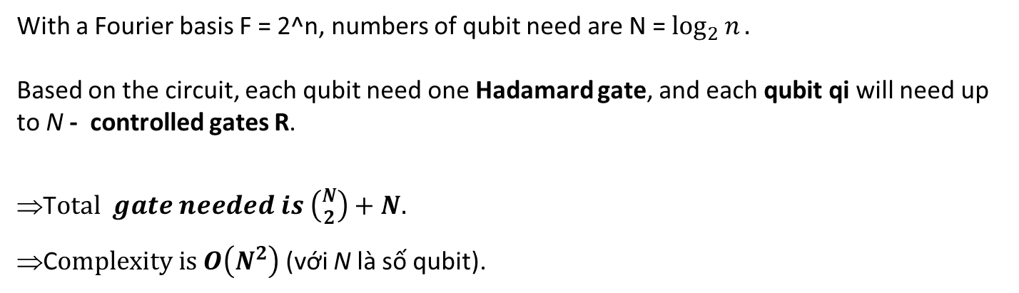

Quantum Fourier Transform
Complexity of QFT is ${\log_{2}{N}}^{2}$.
With a Fourier basis F = 2^n, numbers of qubit need are N = $\log_{2}{n}.$
Based on the circuit, each qubit need one Hadamard gate, and each qubit qi will need up to N - controlled gates R.
T$otal gate needed is \left({N \atop 2}\right)+N.$
C$omplexity is O\left(N^{2}\right)$(với N là số qubit).

Slide 19
3. QFT convolution

Slide 20
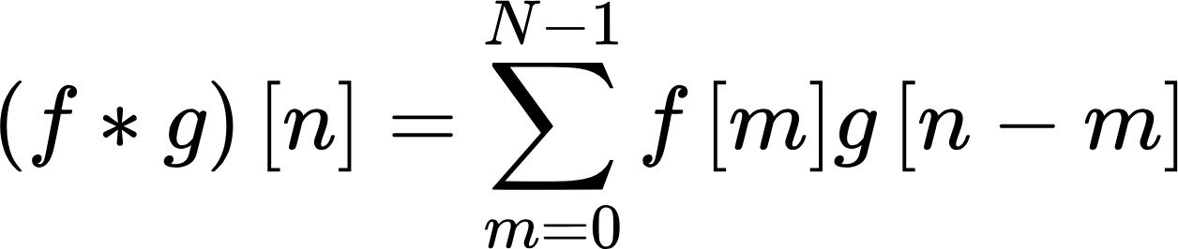
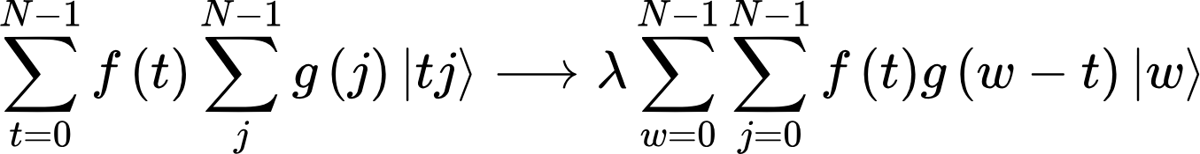
Quantum convolution
The discrete convolution of two sequences:
We define the quantum convolution as process P that performs:

Slide 21
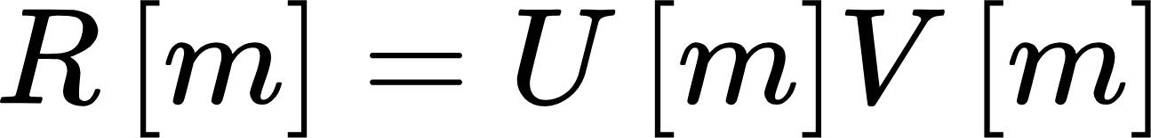
The convolution theorem
Consider 2 sequences u[n] and v[n] with Fourier transforms U and V. The discrete convolution of u and v is denoted as r[n]. Then, the Fourier transform R of r is equal to the product of U and V:

Slide 22
The procedure of FFT convolution
Step 1: Calculate the FFT of input i (size M*N) and kernel k (size m*n). Let I and K denote these transforms respectively.
Step 2: Calculate the (element-wise) product P=IK.
Step 3: Take the IFFT of P. The result is the convolution of i and k.
Complexity of FFT convolution: O(MNlog(MN))
Complexity of normal convolution: O(MNmn)

Slide 23
The QFT version of the procedure?
Step 1: Calculate the QFT of input i (size M*N) and kernel k (size m*n). Let I and K denote these transforms respectively.
Step 2: Calculate the (element-wise) product P=IK.
Step 3: Take the IQFT of P. The result is the convolution of i and k.

Slide 24
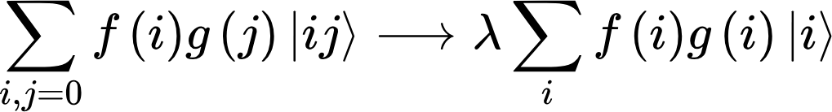
The QFT version of the procedure?
Step 1: Calculate the QFT of input i and kernel k. Let I and K denote these transforms respectively.
Step 2: Calculate the (element-wise) product P=IK.
Step 3: Take the IQFT of P. The result is the convolution of i and k.
Step 2 is not realizable physically. That is, there’s no physical process P capable of the transformation(*):
*Chris Lomont. "Quantum convolution and quantum correlation algorithms are physically impossible." (2003). Theorem 16.

Slide 25
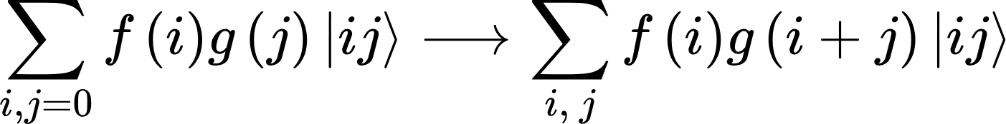
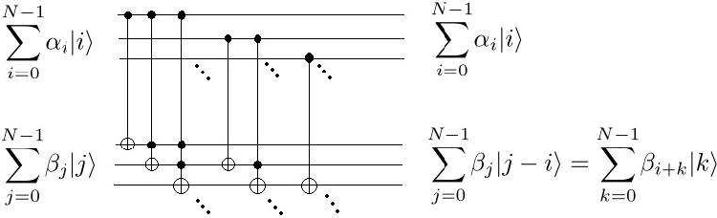
The QFT convolution circuit
The problem is tackled by replacing the element-wise product with the process M that performs the following transformation:
The circuit of the transformation(*):
*Guangsheng Ma, Hongbo Li, and Jiman Zhao. "Windowed Fourier transform and general wavelet algorithms in quantum computation." (2019).

Slide 26
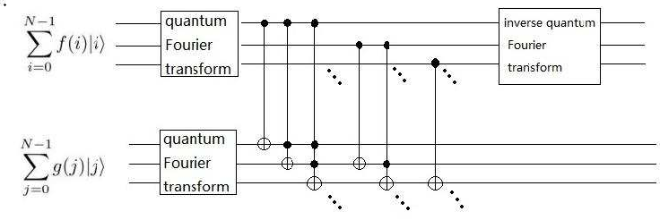
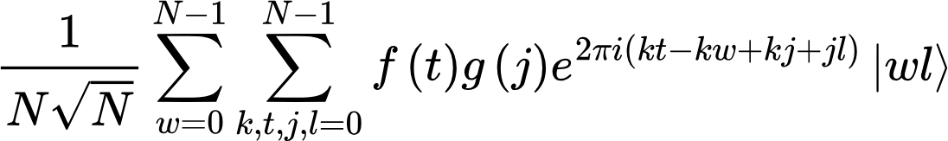
The QFT convolution circuit
The QFT convolution circuit is then:
The result of the circuit is:

Slide 27

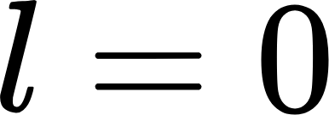
The QFT convolution circuit
The quantum convolution can be written as:
(We can prove this by applying QFT and then IQFT to the left-hand side)
Compare this to the result of the circuit:
We see we can get the (normalized) convolution when is observed.

Slide 28
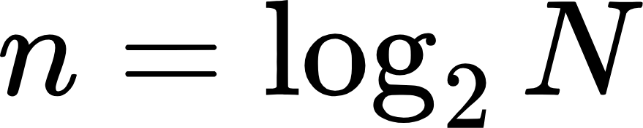
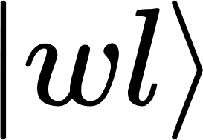


Measurement
The output state of the circuit can be expressed in binary representation:
Where
The value of the nth element of the convolution is equal to the amplitude of the eigenstate of where and
( can be understood as the indices of the convolution sequence and the amplitude of the corresponding eigenstate as the value at that index)

Slide 29
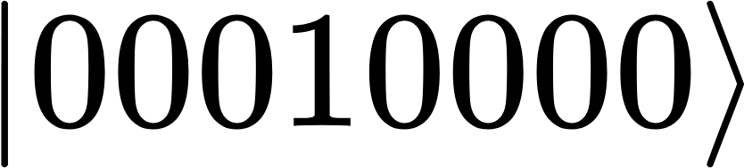


Measurement
For example, let the convolution of f[n] and g[n] be r[n], 0<n<10 (so we need 8 qubits, 4 for input and 4 for kernel). The normalized r[1] is the amplitude of the eigenstate:
The state of the system can be express as:

Slide 30
Quantum state tomography
Quantum state tomography is a process by which the quantum state is reconstructed using measurements on an ensemble of identical states, i.e. reconstructing the density matrix of the state by measuring multiple copies of the state.
However, normal state tomography algorithms require a lot of resources (increased exponentially with the number of qubits for full state tomography and quadratically for incomplete measurement).

Slide 31
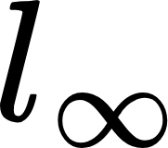
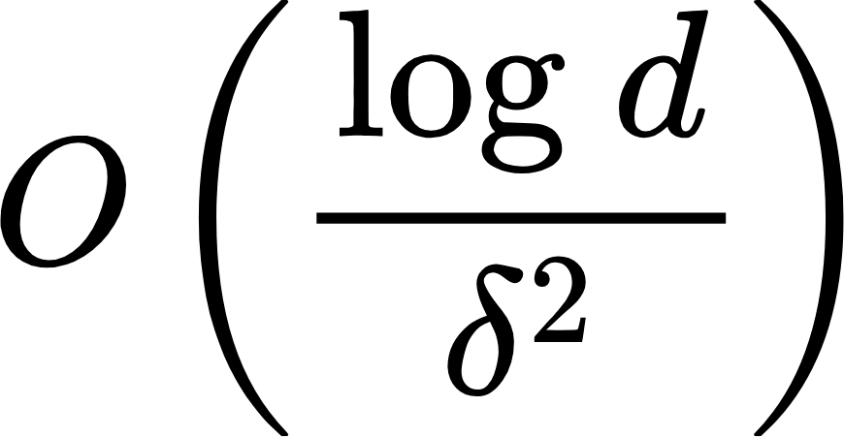

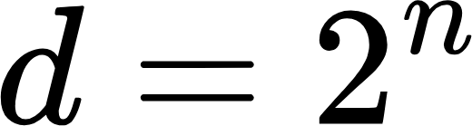

Quantum state tomography
Here, we use the vector state tomography algorithm (*). This algorithm can give us the value of the amplitude with norm guaranteed with much less resources. The complexity of tomography is:
In which is the dimension of the space ( ) and is the precision parameter. Although this method of tomography has a better complexity, it is still a lot to try to simulate on a classical computer
*Iordanis Kerenidis, Jonas Landman, and Anupam Prakash. "Quantum algorithms for deep convolutional neural networks." (2019).

Slide 32
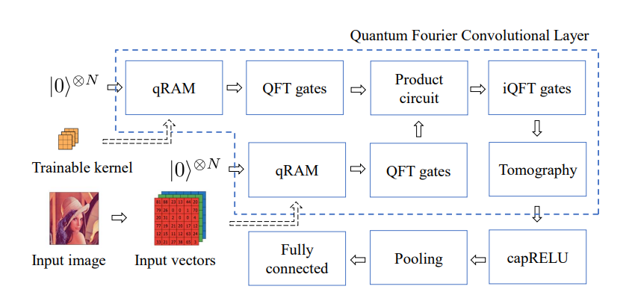
Illustration of our QFCN with a quantum Fourier convolutional layer.

